Slide 1
CS 589 Fall 2021 Lecture 6
Topic model
Monday 6:30-9:00
Babbio 122
All zoom links in Canvas
photo: https://www.scubedstudios.com/information-retrieval/
Notes:
In this lecture, we will be talking about probabilistic ranking models, which is

Slide 2
Review of Lecture 5
The idea of machine learning for ranking has been around for a long time
Learning to rank can be turned into a classification or regression problem
LTR algorithms:
Multiple additive regression tree (MART)
RankNet
LTR categories:
Pointwise
Pairwise
Listwise
Yahoo! Learning to rank challenge (Tree ensemble algorithm wins!)
Notes:
For the simplest method for learning to rank, we can simply leverage a binary classification or a regression algorithm, where in classification, we retrieve the documents where the predicted label is 1, and in regression, we rank the documents based on their predicted score.
Next we talked about two learning to rank algorithms, i.e., MART and RankNet.

Slide 3
Review of Lecture 5
Multiple additive regression tree (MART)
Minimizes the square loss (i.e., just like linear regression and regression tree)
First iteration: f0(x) = avg of all y_i
From iteration 1 through k:
Update the residual of each y_i
Fit a regression tree fk(x) for the residuals
Update the sum F(x)
The name “gradient boosting regression tree” comes from the fact that the residual = gradient of the objective function

Slide 4
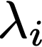
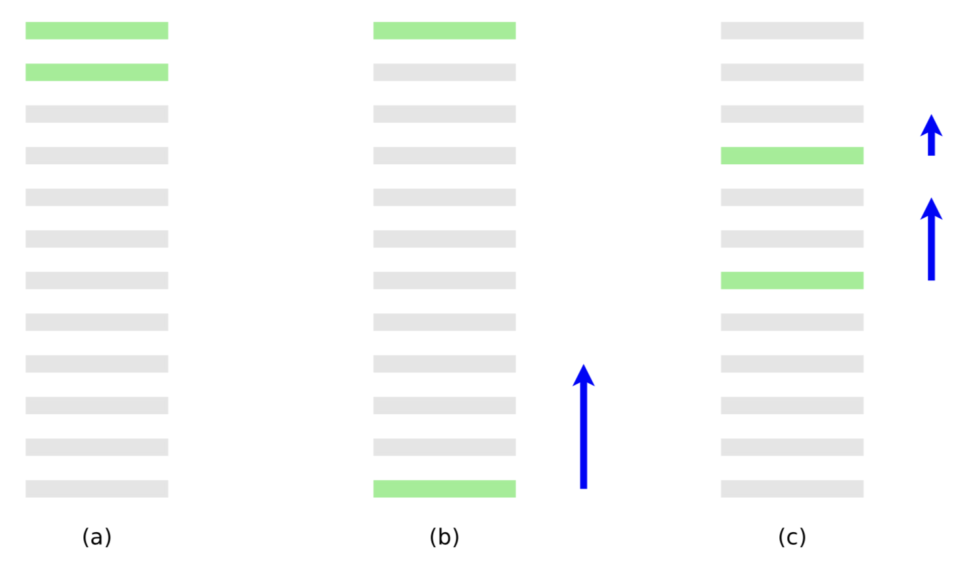
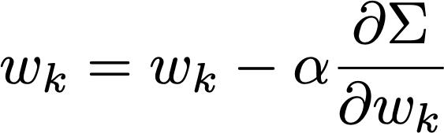
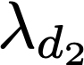
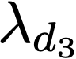
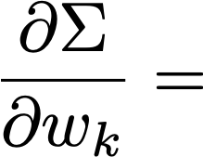
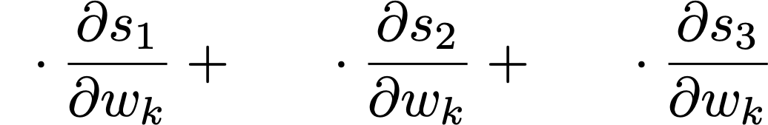
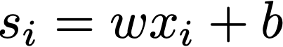
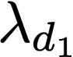
Review of Lecture 5
RankNet
Convert the pairwise loss function to the summation of for each document di
That is, is a sort of “gradient” with respect to di
d2
d3
d1

Slide 5
Lecture 6: Topic model
Pop quiz
Expectation maximization
Probabilistic topic model
The toy coin topic problem
Probabilistic latent semantic analysis
Latent Dirichlet allocation
Bayesian inference of topic model
Variational inference for LDA
Gibbs sampling, Markov chain Monte-Carlo
Notes:
For the simplest method for learning to rank, we can simply leverage a binary classification or a regression algorithm, where in classification, we retrieve the documents where the predicted label is 1, and in regression, we rank the documents based on their predicted score.
Next we talked about two learning to rank algorithms, i.e., MART and RankNet.

Slide 6

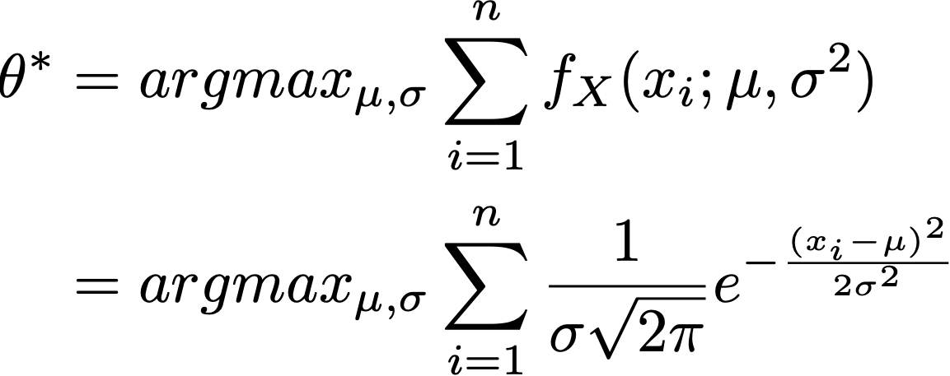
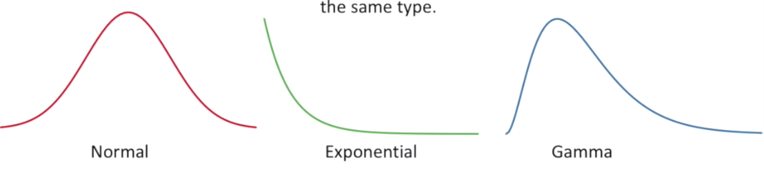
Maximum likelihood estimation
Estimating the underlying distribution behind the observations
i.e., by building a model with parameter and find the that maximizes the likelihood of the observation
Example 1: Estimating the weights of mice from observations x1,...,xn
Notes:
we use Google playstore data as the data source, so we collect these data, we clean it, we split the sentence, and we build a filtering algorithm to select the high quality sentence

Slide 7
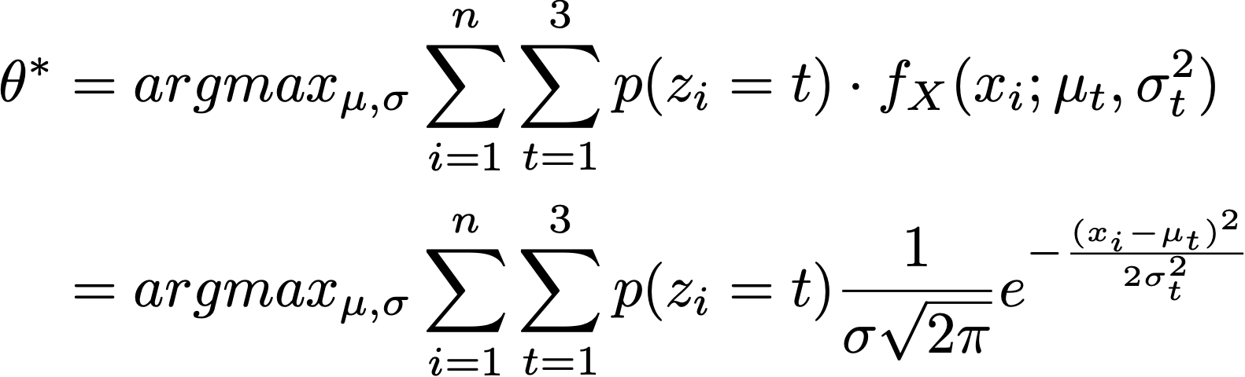
Maximum likelihood estimation for mixture models
Example 2: Estimating the weights of mice from observations x1,...,xn
latent variable zi: which topic xi comes from
Notes:
we use Google playstore data as the data source, so we collect these data, we clean it, we split the sentence, and we build a filtering algorithm to select the high quality sentence

Slide 8
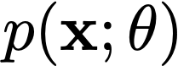
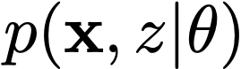
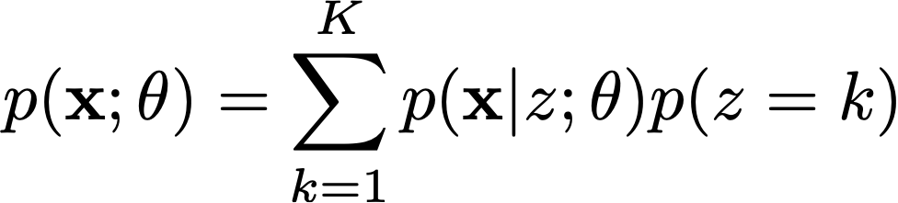
Expectation Maximization
The expectation maximization algorithm is an algorithm for maximum likelihood estimation under the latent space assumption
Likelihood of the incomplete space: the observation
Likelihood of the complete space: the observation + the latent variable, e.g., the latent topic
Estimating the incomplete probability by marginalizing out the complete space
Notes:
we use Google playstore data as the data source, so we collect these data, we clean it, we split the sentence, and we build a filtering algorithm to select the high quality sentence

Slide 9
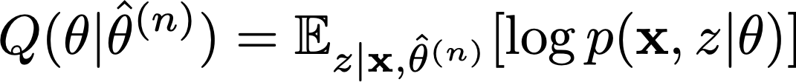
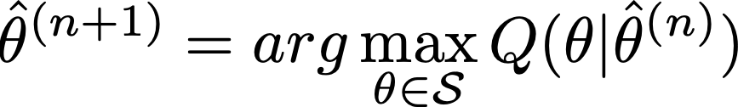
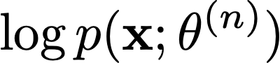
Expectation maximization algorithm
EM algorithm: repeat n=1…N:
Theorem: the likelihood of observation, , monotonously increases with n (Proof on whiteboard)
E step:
M step:
Notes:
we use Google playstore data as the data source, so we collect these data, we clean it, we split the sentence, and we build a filtering algorithm to select the high quality sentence

Slide 10
Expectation maximization: convergence guarantee
Theorem: the likelihood of observation, , monotonously increases with n
Proof:
Notes:
we use Google playstore data as the data source, so we collect these data, we clean it, we split the sentence, and we build a filtering algorithm to select the high quality sentence

Slide 11
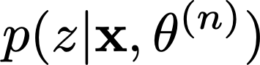
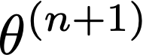
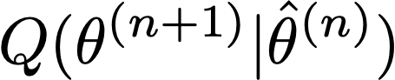
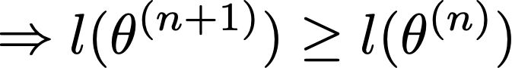
Expectation maximization: convergence guarantee
Take the expectation over on both side
EM chooses to maximize
KL divergence always nonneg
Notes:
we use Google playstore data as the data source, so we collect these data, we clean it, we split the sentence, and we build a filtering algorithm to select the high quality sentence

Slide 12

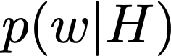
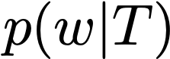
An example problem: Coin-topic problem
Author H and author T are co-authoring a paper in the following way:
At each time, they toss a coin to write the next word. If it’s “head”, author H writes the next word, if it’s “tail”, author T writes the next word. The probability for “head” is
The head author selects the next word by randomly sampling from , the tail author selects the next word by randomly sampling from
Notes:
we use Google playstore data as the data source, so we collect these data, we clean it, we split the sentence, and we build a filtering algorithm to select the high quality sentence

Slide 13
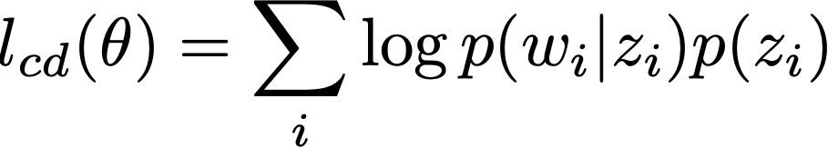

Problem 1: and are known, estimate
where both head and tail distributions are known, e.g.:
 | the | computer | data | baseball | game | interesting
p(w|T) | 0.2 | 0.05 | 0.05 | 0.4 | 0.2 | 0.1
p(w|H) | 0.25 | 0.2 | 0.2 | 0.15 | 0.1 | 0.1
Notes:
we use Google playstore data as the data source, so we collect these data, we clean it, we split the sentence, and we build a filtering algorithm to select the high quality sentence

Slide 14
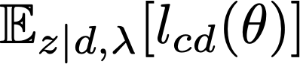
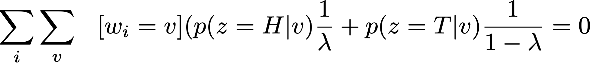
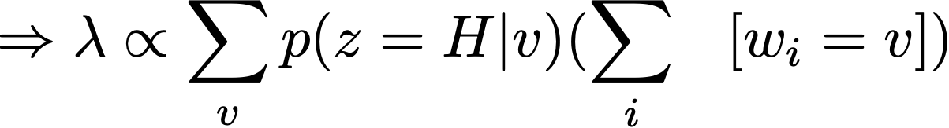
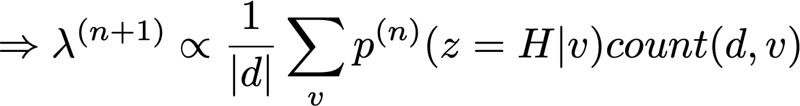
Expectation maximization
Find that maximizes (take the derivative):
(M step)
Notes:
we use Google playstore data as the data source, so we collect these data, we clean it, we split the sentence, and we build a filtering algorithm to select the high quality sentence

Slide 15
Expectation maximization
E step: apply Bayes' theorem:
Notes:
we use Google playstore data as the data source, so we collect these data, we clean it, we split the sentence, and we build a filtering algorithm to select the high quality sentence

Slide 16
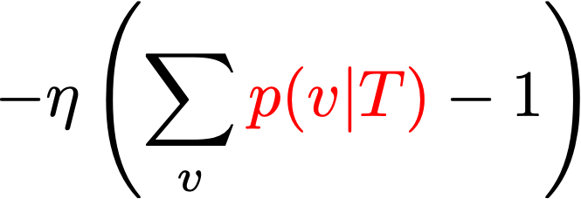
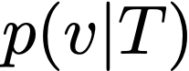
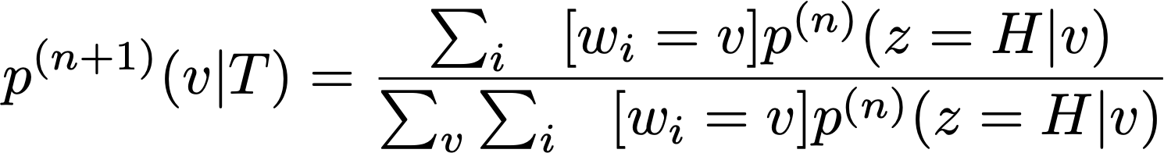
Problem 2: and known, estimating
Take the derivative for and set to 0, we can get (M step):
Notes:
we use Google playstore data as the data source, so we collect these data, we clean it, we split the sentence, and we build a filtering algorithm to select the high quality sentence

Slide 17
Problem 2: and known, estimating
Take the derivative for and set to 0, we can get (M step):
(E step same as Problem 1)
Notes:
we use Google playstore data as the data source, so we collect these data, we clean it, we split the sentence, and we build a filtering algorithm to select the high quality sentence

Slide 18
Problem 2: and known, estimating
How can Problem 2 be useful?
Suppose p(w|T) is the main topic (Python)
p(w|H) is the background topic (StackOverflow general question)
The mixture of head and tail topic is dominated by background words:
After stop words removal, the true topic p(w|T) is “revealed”:
Notes:
we use Google playstore data as the data source, so we collect these data, we clean it, we split the sentence, and we build a filtering algorithm to select the high quality sentence

Slide 19
Problem 3: Unknown topic and
Suppose p(w|H) is unknown, but p(w|T) and lambda are both unknown:
Use Problem 1 to estimate lambda
Use Problem 2 to estimate p(w|T)
Same E step
Notes:
we use Google playstore data as the data source, so we collect these data, we clean it, we split the sentence, and we build a filtering algorithm to select the high quality sentence

Slide 20
Applications of Coin Topic Problem for Text Mining
Application Scenarios:
p(w|H) & p(w|T) are known; estimate λ
p(w|H) & λ are known; estimate p(w|T)
p(w|H) is known; estimate λ & p(w|T)
λ is known; estimate p(w|H)& p(w|T)
Estimate λ, p(w|H), p(w|T)
how much percent of the document is about computer game?
30% of the doc is about computer game, what’s the other topic about?
rest about?
The doc is about computer game, is it also about some
other topic, and if so to what extent?
30% of the doc is about one topic and 70% is about
another, what are these two topics?
The doc is about two subtopics, find out what these two subtopics
are and to what extent the doc covers each.

Slide 21
Expectation maximization as hill climbing
next guess
current guess
M step object
converge to local optimal
Slides from UIUC CS510
Notes:
we use Google playstore data as the data source, so we collect these data, we clean it, we split the sentence, and we build a filtering algorithm to select the high quality sentence

Slide 22
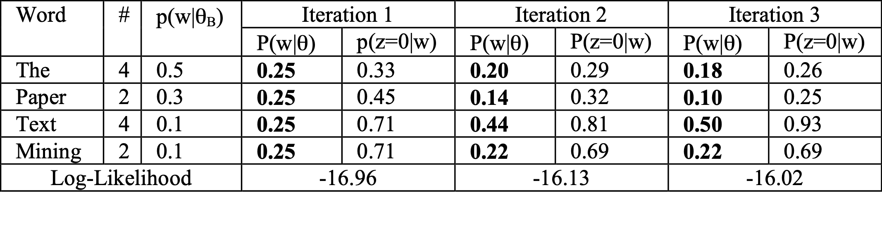
EM algorithm in action
Log likelihood increases:
Notes:
we use Google playstore data as the data source, so we collect these data, we clean it, we split the sentence, and we build a filtering algorithm to select the high quality sentence

Slide 23
Topic models and analysis
Topic ≈ main idea discussed in text data
Theme/subject of a discussion or conversation
Different granularities (e.g., topic of a sentence, an article, etc.)
Many applications require discovery of topics in text
What are Twitter users talking about today?
What are the current research topics in data mining? How are they different from those 5 years ago?
What do people like about the iPhone 6? What do they dislike?
What were the major topics debated in 2012 presidential election?
Slides from UIUC CS510
Notes:
we use Google playstore data as the data source, so we collect these data, we clean it, we split the sentence, and we build a filtering algorithm to select the high quality sentence

Slide 24

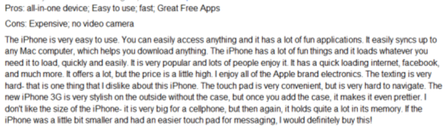

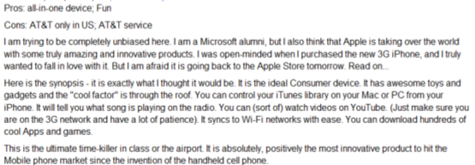

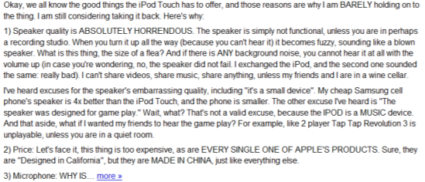
Lifecycle of topic and text data
Non-Text Data
Knowledge about the world
Text Data
Topic 1
+ Context
Time
Location
…
Real World
Topic 2
…
…
Topic k
Slides from UIUC CS510
Notes:
we use Google playstore data as the data source, so we collect these data, we clean it, we split the sentence, and we build a filtering algorithm to select the high quality sentence

Slide 25
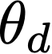
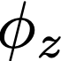
Probabilistic latent semantic analysis
Assume documents are generated by sampling words from k latent topics
For each document d:
For each token position i
Choose a topic z ∼ Multinomial( )
Choose a term w ∼ Multinomial( )
Probabilistic Latent Semantic Analysis. Thomas Hoffman. 2001.

Slide 26
Review of PLSA
Phi T x V, V: vocabulary size ~50,000, T: #topics, T=20
theta D x T, D: #documents: ~10,000, T: #topics, T=20
city 0.2 new 0.1 orleans 0.05 ...
donate 0.1 relief 0.05 help 0.02 ...
government 0.3 response 0.2 ...
the 0.04 a 0.03 ...
Orleans 0.05
0.5
0.3
0.1
0.1
[ Criticism of government response to the hurricane ..] to the [ flooding of New _______
[ Criticism of government response to the hurricane ..] to the [ flooding of New Orleans
Step 1: sample a topic: topic 2
Step 2: sample a word from topic 2
Probabilistic Latent Semantic Analysis. Thomas Hoffman. 2001.

Slide 27
Document as a Sample of Mixed Topics
government 0.3 response 0.2 ...
Blog article about “Hurricane Katrina”
Topic θ₁
[ Criticism of government response to the hurricane primarily consisted of criticism of its response to the approach of the storm and its aftermath, specifically in the delayed response ] to the [ flooding of New Orleans. … 80% of the 1.3 million residents of the greater New Orleans metropolitan area evacuated ] …[ Over seventy countries pledged monetary donations or other assistance]. …
city 0.2 new 0.1 orleans 0.05 ...
Topic θ₂
…
donate 0.1 relief 0.05 help 0.02 ...
Topic θ_{k}
Background θ_{B}
the 0.04 a 0.03 ...
proportion of topics

Slide 28
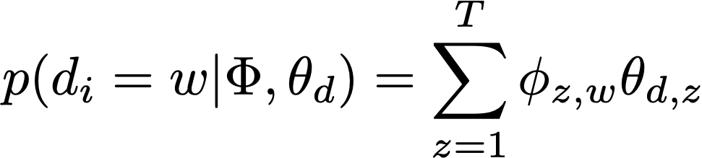
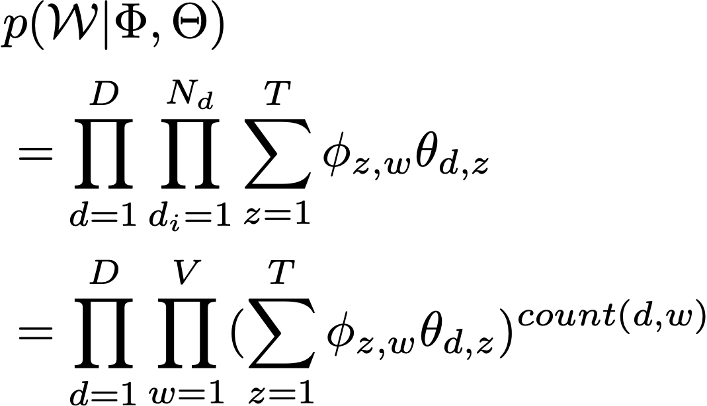
Probabilistic latent semantic analysis
Notes:
we use Google playstore data as the data source, so we collect these data, we clean it, we split the sentence, and we build a filtering algorithm to select the high quality sentence

Slide 29
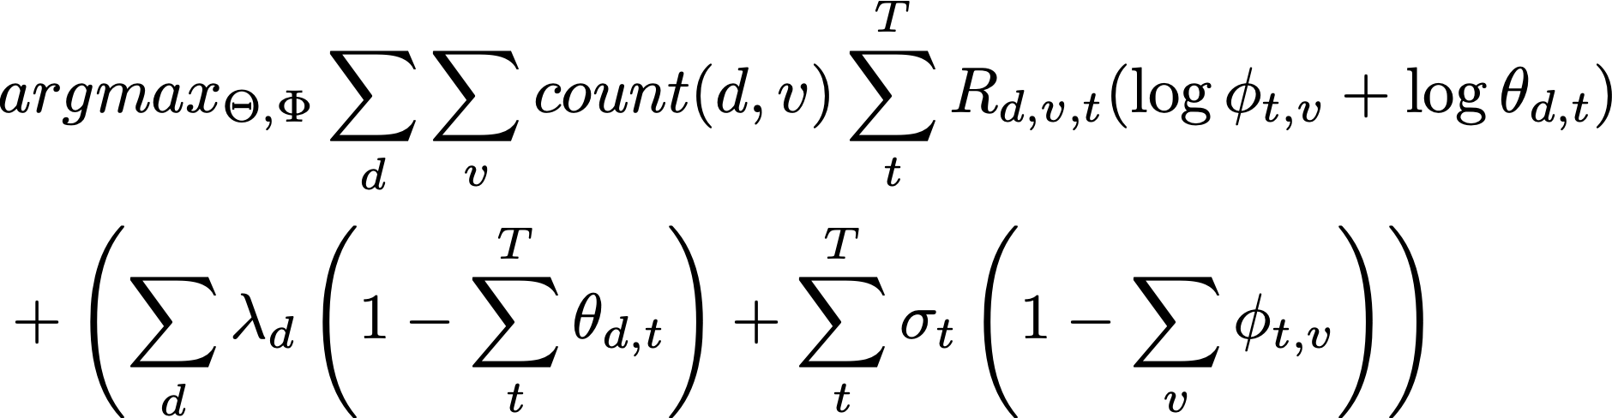
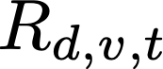
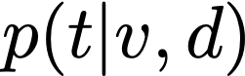
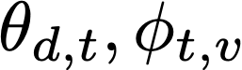
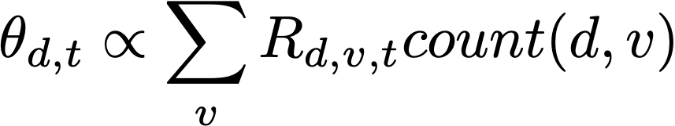
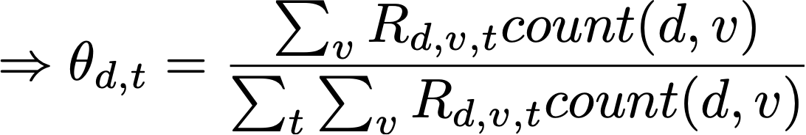
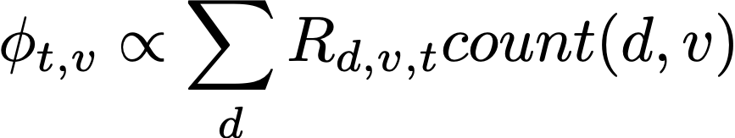
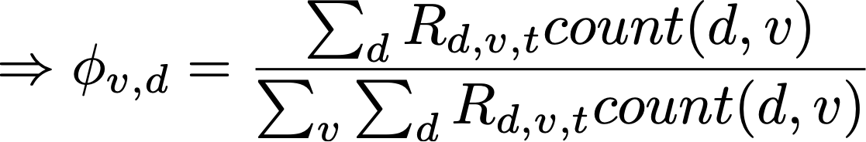
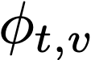
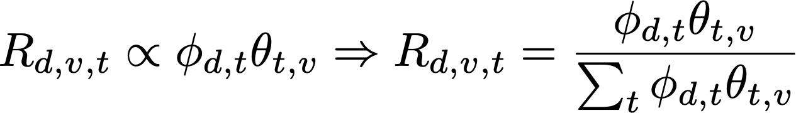
Probabilistic latent semantic analysis
M step: take the derivative of the above formula for :
E step: apply Bayes theorem:
: latent variable's conditional probability, i.e.,
Notes:
we use Google playstore data as the data source, so we collect these data, we clean it, we split the sentence, and we build a filtering algorithm to select the high quality sentence

Slide 30
Probabilistic latent semantic analysis: partially available labels
Generalized topic modeling:
Each document can contain just one topic, e.g., short documents
That is, topic inference = topic classification
If we already know the document tags for a part of the documents, does the partial labels help us make better predictions for the entire corpus? (Homework 3)
Example: news tagging, StackOverflow question tagging
Notes:
we use Google playstore data as the data source, so we collect these data, we clean it, we split the sentence, and we build a filtering algorithm to select the high quality sentence

Slide 31
Probabilistic latent semantic analysis: partially available labels
Notes:
we use Google playstore data as the data source, so we collect these data, we clean it, we split the sentence, and we build a filtering algorithm to select the high quality sentence

Slide 32
Homework 3
Suppose each document has only 1 topic. We have two document set: S1 (100 documents) contains all the tagged documents; S2 (10,000 documents) contains all the untagged documents. Each tag is a topic, there are only 2 topics
(Part 1): derive the EM algorithm using pLSA that maximizes the probability of the observed document, given the known topics from S1
(Part 2): implement your EM algorithm, output the predicted topic for each document in S2
Slides from UIUC CS510
Notes:
we use Google playstore data as the data source, so we collect these data, we clean it, we split the sentence, and we build a filtering algorithm to select the high quality sentence

Slide 33
CS 589 Fall 2021 Lecture 6
Latent Dirichlet allocation
Monday 6:30-9:00
Babbio 122
All zoom links in Canvas
photo: https://www.scubedstudios.com/information-retrieval/
Notes:
In this lecture, we will be talking about probabilistic ranking models, which is

Slide 34

Latent Dirichlet allocation [Blei et al. 03]
A Bayesian topic model by considering the prior distribution of p(t|d)
pLSA assumes is a variable by itself
LDA assumes is drawn from yet another distribution (i.e., "distribution of distribution")
LSI (1998)
PLSA (2002)
LDA (2003)
Notes:
we use Google playstore data as the data source, so we collect these data, we clean it, we split the sentence, and we build a filtering algorithm to select the high quality sentence

Slide 35



Latent Dirichlet allocation [Blei et al. 2003]
Adding a prior hyper parameter to PLSA model
The document-topic probability is randomly sampled from the same prior distribution
That is, when computing the probability, we include in the model
alpha’s dimension: k - 1
beta’s dimension: V - 1
Notes:
we use Google playstore data as the data source, so we collect these data, we clean it, we split the sentence, and we build a filtering algorithm to select the high quality sentence

Slide 36



Bayes’ rules
Chain rule:
joint distribution
Bayes’ rule:
posterior
likelihood
prior
Notes:
Next let’s review the Bayes’ rules. The chain rule says the join probability of two event A and B to happen is equal to the…
If we divide both side by P(B), we can get the Bayes rule. The bases rule says the conditional probability …

Slide 37

PLSA -> LDA
city 0.2 new 0.1 orleans 0.05 ...
donate 0.1 relief 0.05 help 0.02 ...
government 0.3 response 0.2 ...
the 0.04 a 0.03 ...
Orleans 0.05
0.1
?
0.5
?
0.3
?
?
0.1
Step 0: sample topic distribution
[ Criticism of government response to the hurricane ..] to the [ flooding of New _______
[ Criticism of government response to the hurricane ..] to the [ flooding of New Orleans
Step 1: sample a topic: topic 2
Step 2: sample a word from topic 2

Slide 38


Maximum a Posterior (MAP) estimation
Maximum likelihood estimation:
Choose the parameter with the maximum posterior probability
LDA is the MAP version of pLSA (MLE)
Notes:
we use Google playstore data as the data source, so we collect these data, we clean it, we split the sentence, and we build a filtering algorithm to select the high quality sentence

Slide 39





PLSA -> LDA
PLSA:
LDA:
marginalized probability:
Notes:
we use Google playstore data as the data source, so we collect these data, we clean it, we split the sentence, and we build a filtering algorithm to select the high quality sentence

Slide 40

Solving Maximum a Posteriori inference for LDA
Exact inference is intractable:
Equation (1) is computationally intractable due to the coupling of beta and phi in the denominator
Notes:
we use Google playstore data as the data source, so we collect these data, we clean it, we split the sentence, and we build a filtering algorithm to select the high quality sentence

Slide 41
Variational inference
Key idea: use a surrogate distribution to approximate the posterior distribution of latent variables
Surrogate distribution is simpler to estimate than the true posterior
Goal: finding the “best” surrogate distribution from a certain parametric family by minimizing the KL-divergence between the surrogate function (Q) to the true posterior (P)
Notes:
we use Google playstore data as the data source, so we collect these data, we clean it, we split the sentence, and we build a filtering algorithm to select the high quality sentence

Slide 42


Evidence lower bound (ELBO)
Given that , we want to minimize the KL divergence between Q(Z) and p(Z|D):

Slide 43

Evidence lower bound (ELBO)
p(D) does not rely on the latent variable Z:
Therefore minimizing KL divergence = maximizing L(q), which we call evidence lower bound, as KL divergence is non-negative
The lower bound is more tractable to optimize than the evidence:

Slide 44


LDA variational inference
Assumption: q belongs to a family of distribution which can be factorized

Slide 45

LDA variational inference
ELBO of LDA under the factorization assumption:
and integrated out

Slide 46


LDA variational inference
LDA variational inference algorithm: optimizing γ, φ, β
Randomly initialize variational parameters (can’t be uniform)
For each iteration:
For each document, update γ and φ
For corpus, update β
Compute L for diagnostics
Return expectation of variational parameters for solution to latent variables

Slide 47
Pros and Cons of Variational inference
Pros
Deterministic algorithm - easy to tell when converged
Embarrassingly parallelizable
Cons:
Speed: make many calls to transcendental functions (no close form solution)
Quality is questionable due to the factorization assumption
Memory usage: requires O(MNK) to store the per-token variational distributions

Slide 48


Monte Carlo for LDA inference
Monte Carlo
A broad class of computational algorithms that rely on repeated random sampling to obtain numerical results
Markov chain Monte Carlo (MCMC)
A Monte Carlo method with the Markov assumption, i.e., the next sample only rely on the previous state

Slide 49



Conjugate prior distribution
That is, the posterior distributions are in the same probability distribution family as the prior probability distribution
The prior is called the conjugate prior of the likelihood probability
Conjugate prior makes denominator easy to compute because you can integrate out theta
e.g., Beta distribution is the conjugate prior of Bernoulli distribution
Bernoulli:
Beta:

Slide 50


Collapsed variational inference [Teh et al. 07]
If your priors are conjugate, they can be integrated out!
Let be the number of times that word v in document d has topic z
Let be the number of times word v in any document has topic z
No theta or phi in the above formula

Slide 51



Collapsed variational inference [Teh et al. 07]
How do we get back phi and theta?
How do we get ?
Gibbs sampling: sample values of Z, count from those examples

Slide 52
Collapsed Gibbs sampling [Griffths et al. 04; Teh et al. 07]
Key idea: construct a well-behaved Markov chain such that
the states of the chain represent an assignment of $Z$
state transitions occur between states that differ in only one z_{d,i}
transition probabilities are based on the full conditional:
where z^{di} is the set of assignments for $Z$ without the i-th word in document d

Slide 53

Collapsed Gibbs sampling [Griffths et al. 04]
iteration
1 2

Slide 54

Collapsed Gibbs sampling [Griffths et al. 04]
iteration
1 2

Slide 55

Collapsed Gibbs sampling [Griffths et al. 04]
iteration
1 2

Slide 56
LDA result

Slide 57
Summary
Expectation maximization
maximizes the lower bound of the likelihood function
guarantee to improve the likelihood
may stuck at local optimal
Know how to derive EM algorithm for coin topic and pLSA
LDA is the Bayesian version of pLSA
Direct inference is intractable
Variational inference (leveraging ELBO)
Markov chain Monte Carlo (Gibbs sampling)
Notes:
describes the desired change of scores for the pair of documents di and dj

Slide 58

Resources for LDA
Mallet: http://mallet.cs.umass.edu/
gensim:
bin/mallet import-dir --input /data/topic-input --output topic-input.mallet \
--keep-sequence --remove-stopwords
Notes:
describes the desired change of scores for the pair of documents di and dj

